Slide 1
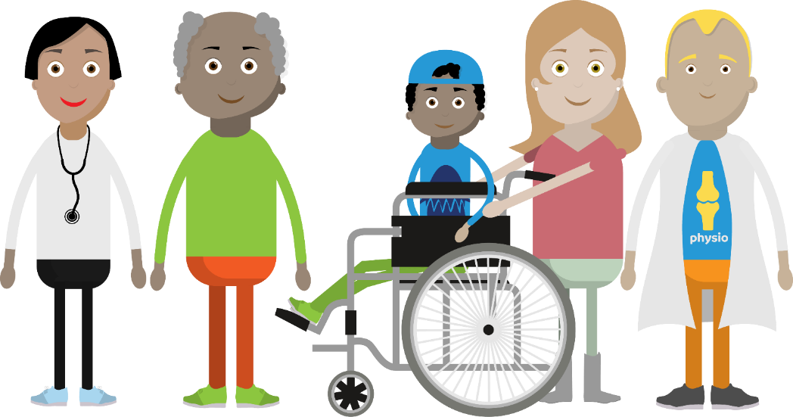
The No Wrong Door
Community Mental Health
‘Thank You’ Event
20th February 2024
Kerry Pearson
Abigail Clarkson / Hannah Anderson
Stuart McDowell / Hannah Duffy
Toni King/ Amelia Norman

Slide 2
Transformation of Community Mental Health Services
National guidance papers supporting change; The Long-Term Plan and The Community Mental Health Framework.
The Vision:
People with mental health problems will be enabled as active participants in making positive changes rather than passive recipients of disjointed, inconsistent and episodic care.
Notes:
This has been the biggest National Mental Health programme of work supported by 3 years of new additional funding

Slide 3
Community Mental Health Framework
Patients should be able to:
Access mental health care where and when they need it
Tell their story once.
Transition seamlessly between services and not fall between gaps in service provision.
Reduction / removal of eligibility criteria - blurred boundaries to meet the needs of the patient.
Receive care and support at the right level and in the most appropriate place.
Be able to manage their condition or move towards individualised recovery on their own terms, surrounded by their families, carers and social networks, and supported in their local community
Contribute to and be participants in the communities that sustain them, to whatever extent is comfortable to them.

Slide 4
Community Mental Health Transformation Programme
The Transformation Co-Production Journey Starts
Discovery Events to Analyse Key Themes
Held with experts by experience, VCSE and clinical staff colleagues to identify issues with current provision, and opportunities for the future
Establish Experts-by-Experience Network Jan 2022
Commissioned the Hive to establish an experts-by-experience network. Key objective to enable feedback and influence change by having experts by experience / carers voice at the table
2021
Hive Staff ran 1:1 groups face to face and virtual to explain the ask, enabling people to get involved. They have worked across the age ranges from 16yr + and with number of different groups such to ensure the widest representation across the city.
Key themes;
Access; People don’t know whats on offer, routes are too confusing / daunting. Significant
differences between Childrens and adult mental health services. Communication between different departments / services. The lack of support whilst on a waiting list
Formulation; Listen to me properly hear my story, help me build a plan specific to my needs
Single point of access; Need one local number to call, with the ability to speak someone who is kind and compassionate and able to help me get the right help and treatment I need
One team which makes up the whole; The mental health system should work as one team or
unit which includes the VCSE. Stop the need for repeating my story and falling through
the gaps.
A holistic approach, remove artificial barriers
Delays between presentation and diagnosis; why is the first step
Medication not self-help? Talking solution alongside
medication not one without the other.
Building trusted relationship with your clinician;
People want trust honesty and consistency.
Its really important to feel heard.
2022
How many other organisations/ services are you working with?
Phase 1
Embed co-production methodology and identify short term interventions
Design Workshops took place in 2022 which led to the design of the Mental Health Access Hub.
Health & Care Portsmouth website was developed and the 16-25 workstream helped to design ‘You are not alone’ campaign alongside young people.
For the 16-25 workstream a workshop, young person's focus groups and survey was completed to help identify what was working well, challenges and ideas for improvement.
2023
Phase 2
Pilot new models of care and evaluate
The Mental health Access Hub opened April 2023
The workshops for the Personality and Trauma informed work held and the proposed model was agreed
2024
Recruitment for The Personality and trauma informed roles
The Enhanced facilitator roles working in primary care aligned with the Access Hub and the Young Person MH engagement workers commence.
Notes:
5 Discovery events from June 21 – Jan 22 had approx. 55 attendees overall
Design Workshops – April – June 22
1st workshop looked at – where do people get info about MH services , what would be helpful at the initial appts , and when moving between appts how do people move to receive ongoing care
It was here the concept for a SPA stemmed from

Slide 5
The Portsmouth Mental Health Access Hub
Abi Clarkson and Hannah Anderson

Slide 6
What is the Hub?
The Hub is a phoneline – 0300 123 6621
Anyone aged 16+ who might want they want some mental support, but not sure where to get help.
Open Monday to Friday, 8am – 6pm
Available to anyone aged 16+, including carers
No Limit on Number of Calls
Operated by fully trained call handlers who will either:
Arrange appointments with our mental health services, or
Offer support to connect with other local organisations
We do not target (but will help them):
People seeking urgent care (the service is for early intervention and prevention)
People aged under 16
People who do not live in Portsmouth

Slide 7
What happens when you call?
Appointment made with:
Positive Minds
NHS Talking Therapies
A2i
CAMHS
OPMH
Support to connect with:
HIVE Portsmouth
Housing
VCSE
Social support
Substance misuse
Homelessness
Veterans
Recovery College
Who?
Anyone aged 16+
contacts the Hub
How?
Call 0300 123 6621
When?
Monday to Friday, 8am-6pm
Fully trained call handlers, experts in the process and able to deal with complex calls

Slide 8
What has the response been so far?
January 2024
Number of calls: 403
Average Daily Calls: 18.3
Total calls from start of service 2915
Trend
Trend of Average calls:
Up 21.5%
“Thank you very much, it’s difficult to talk to family members, you understand how I'm feeling.”

Slide 9
Who is calling, and when?
Calls by age
Was the call helpful?
“I already feel better because I am getting things sorted for myself.”

Slide 10
Impact
How did you hear about us?
Where would you have gone if you did not know about the Hub?
"Brilliant, thank you so much for your support. I will definitely call back if I require any further support.”

Slide 11
Enhanced Facilitators in GP Practices
Hub now has staff directly based within 3 of our 5 Primary Care Networks
Joint venture (and funding) between the GPs and Mental Health
Provide direct support to patients via their own practices (rather than the Hub)
Provide support and education to the Practice staff on Mental Health and where/how to access support
Identifying pathways and opportunities to speed up access to the right services
Launched January 2024

Slide 12
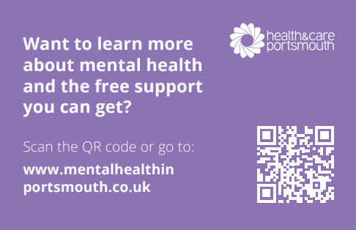
What’s Next
Co-Production of the Hub – Quality and deciding the future together
Strengthen and grow the MH Hub as ‘the’ place to go for mental health in Portsmouth
Simplify and speed up referrals to secondary mental health
Direct referrals into non - Solent commissioned services
Extend Access Options – new website, live chat, in person
PCN Focus – telephone lines, comms, MDT
Enhanced Facilitator (ARRS Roles) and Primary Care MH MDT
Collaborative Comms Approach – internal and external services

