Slide 1
Solent Digital Strategy
2022 - 2025

Slide 2
Contents
| Introduction
| Why do we need a digital strategy?
| New IT Service & 5 Transformation Journeys
| Solent Strategic Priorities - mapped to 5 Transformation Journeys
| How this strategy has been developed
| Regional & national context
| How we’ll deliver the strategy
| Appendices
Summary view of strategy
The details

Slide 3
Introduction
1
Pre-pandemic, digital technologies have been very much a part of our lives for several years and every organisation across every industry sector has to embrace the opportunities and overcome the challenges that come with going on the digital transformation journey.
The pandemic has brought about a rapid adoption of digital technologies and the NHS has seen unprecedented changes. We had to quickly make provision for virtual online consultations and enable staff to work remotely and safely, whilst accessing the information and applications they need to perform their daily duties. The pandemic has shown that we can embrace digital technology.
Building upon those changes, this digital strategy will help in achieving our Trust's strategic objectives, as digital and data can provide the capabilities needed to truly enable a digital workforce, whilst using our data to improve our services for local communities and service users.
We are part of the Hampshire and Isle of Wight Integrated Care System (HIoW ICS) which will become a statutory body in July 2022. This digital strategy will link into the plans for the ICS digital transformation, whilst adhering to national guidance and policies.
This digital strategy covers the timespan of 2022 - 2025
Healthcare Challenges
18 million¹
By 2030, providers will suffer from a projected shortage of healthcare workers globally
6 million²
People on NHS waiting lists in the UK. 300,000+ people waiting over 52 weeks
¹ World Health Organisation Report
² Statement to Parliament (8th Feb 2022)
see appendix

Slide 4
Why do we need a digital strategy?
2
Our vision can’t be achieved without becoming a digitally-mature organisation.
To do this, we have to work together to foster a ‘digital mindset’ culture where we’ll continuously learn, evolve and co-produce our digital capabilities to meet the needs of our staff and of the population we serve.
What this means is that we need to give our staff the best tools and information to do their jobs, and make life easier.
We must give the gift of time³ to our people and this means looking at systems and processes which are sub-optimal and manually intensive, and look to automate them and reduce the administrative burden⁴.
We’ll learn together and develop digital coaching programmes to help us become more skilled in the use of digital tools. Cybersecurity is a threat and we’ll ensure we educate ourselves, keep our systems and software updated, and implement the right controls to minimise any incidents.
It’s important that teams can access up-to-date information that enables data-driven decision-making and continuous improvement. We’ll develop this capability as part of the digital strategy, empowering teams with the right and relevant information.
As an NHS organisation we have to ensure that our digital transformation journey supports the delivery of a ‘net zero’ NHS⁵, through delivering enhanced digital care and working with our partners and suppliers to develop sustainable models of care.
Through staff engagement to help understand our needs, we've identified 5 digital transformation journeys that will help Solent become a digitally mature organisation.
Solent NHS vision:
Health and care teams working with communities to make a difference, so everyone has easy access to safe and effective care, enabling more people to remain well and independent throughout their lives
³ The Topol Review
⁴ NHSX 5 Missions
⁵ Delivering a ‘Net Zero’ National Health Service
See appendix

Slide 5
New IT Service & 5 Transformation Journeys
3
Digital and data transformation – we will improve the experience of staff and service users by implementing digital solutions which optimise existing practice, innovate new practice and enable effective decision making through excellent data and business intelligence.
Source: Solent NHS Strategy 2021 - 2026
New
IT Service
Information Journey
Approved by Solent Trust Board – a new IT Service will be implemented in FY22/23
Efficiency Journey
Through staff engagement exercises we have identified 5 digital transformation journeys
Service User Focus Journey
Workforce Journey
System Integration Journey
This will provide the foundations for digital transformation

Slide 6
3
Information Journey
Laying the foundations for digital transformation – a new IT Service
Ambition
New
IT Service
For the last few months, many people have been involved in a lengthy procurement programme.
The contract with our current supplier finishes up this year and we will begin implementing a new IT Service with new suppliers from July 2022 onwards.
What does this Mean?
We will have a new IT Support Desk with multiple routes to access help with a better experience
Our aging laptops & PCs will be replaced from July onwards, giving our staff the right tools
Our aging network infrastructure (the plumbing), will be replaced and will provide better Wi-fi and connectivity
We will improve upon our understanding, management, exploitation and governance of our information.
What does this mean?
We have many sources of information that could be managed better to help us understand and improve on the services we offer. Having the right information available at the right time helps us to know what’s going on with our services, to understanding trends, and empowers decision-making on the frontlines.
We’ll Deliver
one year | three years | three – five years
Single source of the truth for our data and our information assets will be managed. | Data from different sources will be integrated and can be queried. | Ability to query organisational, local and national data sets to derive insight.
The ability to generate actionable insights from our data, including capacity modelling and trend analysis. | Unstructured data will be mapped and curated. | Our systems will prevent mismanagement and loss of data.
Self-service function for our business intelligence. | Developed AI-enabled insights from our data.

Slide 7
3
Efficiency Journey
Service User Focus Journey
Ambition
Ambition
Infrastructure, applications, systems & processes are increasingly simplified, well designed, efficient and productive.
Co-design increasingly delivers a consumer-focused approach to improved safety, effectiveness and user experience.
What does this mean?
What does this mean?
We know that our systems and processes could be much improved, making it easier for staff to do their jobs. This includes looking at those manual processes that take up our time and automating where we can, to let staff spend more time with patients and other tasks.
We need to engage more with the people we serve to understand where digital services can benefit them. This includes giving patients access to records and services through digital and through other means, to ensure those that are digitally excluded are supported.
We’ll Deliver
We’ll Deliver
one year | three years | three – five years
Develop a cyber security programme to educate staff, implement controls and monitoring to protect our information. | Internet of Things (IoT) sensors will be adopted within Solent buildings. | Smart buildings are utilised across the whole estate.
Robotic process automation (RPA) will be trialled to reduce the administrative burden. | Will have a robotic process automation (RPA) programme in place, that reduces manual processes. | Knowledge management system implemented.
Intelligent scheduling will be implemented into our Electronic Patient Record. | Patients can access and interact with health records.
Processes will be in place to prioritise and support digital improvements. | The number of applications we have to use will be rationalised.
Electronic whiteboards will be introduced to wards. | Clinical systems will be available on any device.
one year | three years | three – five years
Engagement with our community and set up a ‘digital panel’ where citizens can contribute towards digital developments. | Develop and publish a set of design and usability principles to address digital exclusion. | Digital feedback loops will be used to monitor and inform continuous improvement.
Patient-facing digital systems will be reviewed and checked to ensure they are accessible, easy to use, and improvements are made where needed. | Digitised care pathways will adhere to those design principles.

Slide 8
3
Workforce Journey
System Integration Journey
Ambition
Ambition
Staff, from board to floor, become increasingly trusting, competent and innovative with digital solutions to optimise and innovate.
Solent's digital activities increasingly align and blend with the wider health and social care information.
What does this mean?
What does this mean?
In helping our staff to ‘go digital’, we’ll be best placed to use digital tools to make improvements to the services we provide. Developing our digital skills collectively will help us to reimagine new ways of working.
Across the NHS, we are on the path to digital transformation and need to work with our colleagues to share learning, best practise and joint working. We have national objectives to meet as well as meeting the needs of our local and regional population.
We’ll Deliver
We’ll Deliver
one year | three years | three – five years
Work with our staff to develop digital coaching and learning activities and adopt a digital mindset. | National, regional and local training resources for digital will be utilised. | Professional accreditation for healthcare informaticians and entry pathways.
System usability issues will be identified and a plan created to improve our systems. | A digital skills framework will be introduced to help people.
Develop our ability to harness innovation, giving staff the opportunity to bring ideas forward to help improve what we do.
one year | three years | three – five years
Peer to peer relationships with key ICS and partner organisation counterparts will have been mapped. | Solent takes a leadership role in organisational and ICS customs/practises alignment. | Solent customs and practises only differ from wider ICS by exception.
A mechanism ensuring coordination between partners will have been constructed. | Barriers for information flows in/out of Solent are diminished.
Our digital strategy contributes and aligns to the Hampshire & Isle of Wight Integrated Care System (HIoW ICS) digital strategy, due in July 2022.

Slide 9
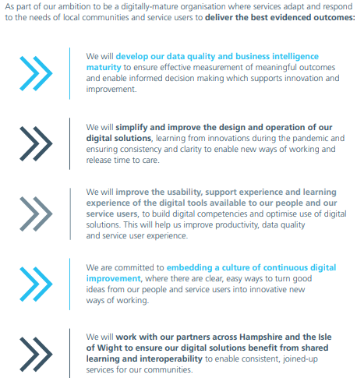
4
5 key Trust objectives mapped to 5 digital transformation journeys
Digital and data transformation – we will improve the experience of staff and service users by implementing digital solutions which optimise existing practice, innovate new practice and enable effective decision making through excellent data and business intelligence.
Source: Solent NHS Strategy 2021 - 2026
Information Journey
Efficiency Journey
Service User Focus Journey
Workforce Journey
System Integration Journey

Slide 10
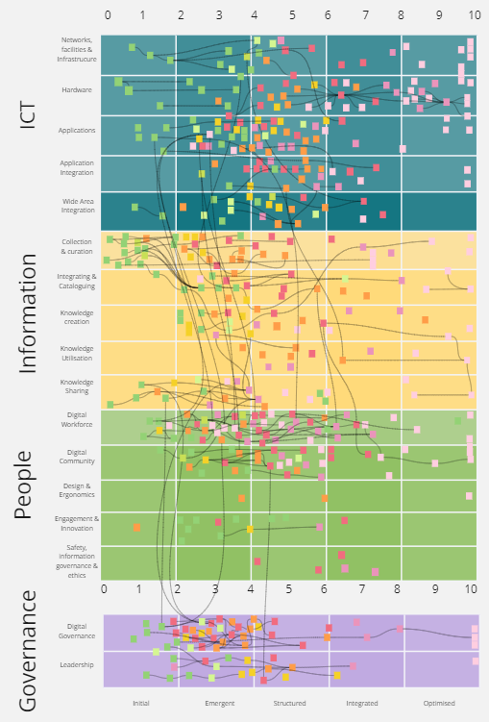
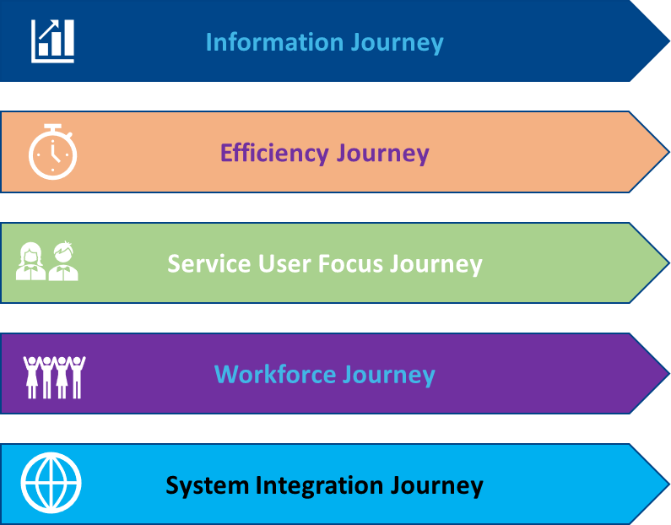
How This Strategy Has Been Developed
5
7 years of end user experience collected
stakeholder coproduction with 7 service lines & 12 corporate teams
426 waypoints identified
5 digital transformation journeys identified
conversations with 40-50 internal and external leaders
Solent Digital Strategy
NHS Long Term Plan
NHSX ‘Data saves lives’
NHSX ‘What Good Looks Like’
Emerging ICS Digital Strategy
Solent Overall Strategy
Solent Clinical Strategy
Drivers of our
Digital Strategy
The development of this strategy arose from a recognition that the digital agenda is necessarily wider than that which can be delivered by ICT team following an ICT strategy, both from the perspective of our organisational needs and as a response to external drivers.
Leaders and stakeholders from all corporate teams and service lines were canvassed to develop a list of projects, programmes and aspirations that they were currently involved in, which were in turn mapped as waypoints on the journey towards a digitally mature future.
The resulting picture was then scrutinised and added to by a group representing the current and future end users of Solent's digital estate, over the course of 9 workshops, to ensure its fitness for purpose.
This led to the requirement for the organisation to embark on five transformation journeys
Throughout this exercise, the emerging strategy was compared and contrasted to the ICS digital strategy, and the strategies of local partners and kept under review for alignment with national strategic drivers. It was presented, discussed and adapted at various leadership events and board workshops.
Waypoints on the journey to digital maturity
5 strategic journeys

Slide 11
Regional and National Context
6
Long Term Plan (LTP) published
What Good Looks Like (WGLL) digital transformation guidance and framework for NHS leaders at system and organisation level.
Funding (digital) will be based upon this framework.
5 key goals for digital:
Empowering people
Supporting health & care professionals
Supporting clinical care
Improving population health
Improving clinical efficiency and safety
ICS digital transformation plan to be ready for FY22
2019
2020
2021
2022
2023
ICSs become a statutory body (July)
From a national perspective, key goals from central policies have been taken into consideration and guidelines used to develop this digital strategy.
Regionally, we are engaged & involved with Hampshire & Isle of Wight Integrated Care System (HIoW ICS) in developing the ICS digital transformation plan. Solent’s digital strategy aligns and complements those plans.
Draft strategy published: Data Saves Lives
‘the role that data will play in that transformation and how it can inspire effective collaboration across the NHS, adult social care, and public health, help us care for people in the best possible way, and ensuring that our citizens have the best experience possible when using the system’
See appendix for further detail

Slide 12
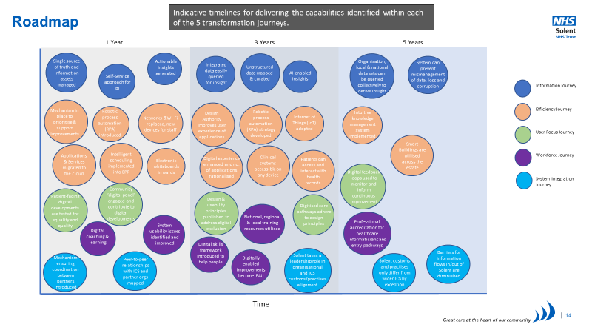
How We’ll Deliver The Strategy
7
We have a comprehensive structure* in place to track and ensure delivery of the Digital Strategy
Managing the change
Keeping staff involved and patients informed and engaged
Delivering the many projects will require us to standardise our project management practises and reporting. This includes developing business cases for each area of investment, coupled with agreed ways of achieving & measuring the benefits of the change.
Community Digital Panel
We’ll involve our patients and their families & carers through working with our partners to engage and include citizens on digital developments
Trust Board
Will receive regular updates on the delivery of the Digital Strategy
Digital Prioritisation Group
We’ll promote our DPG to involve and listen to staff who bring ideas to make digital improvements, working across boundaries to support each other in new ways of working
Digital Information Group
Will oversee the delivery of the Digital Strategy, all associated programmes of work including business cases & management of risk.
Sub-Groups
Will monitor and manage the detailed delivery of projects against milestones
Sharing News
We’ll send out regular updates to keep staff up to date with progress and raise awareness of how to get involved
*See appendix for full governance structure

Slide 13
Appendices
8
Regional and National Context
Where we are now
Harnessing Innovation
Governance
Roadmap on a page
References

Slide 14
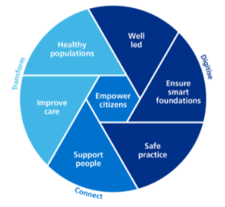
Regional and National Context
8
National
In 2019 NHS England set out its long term plan which focuses on 5 key goals for digital transformation:
Empowering people
Supporting health and care professionals
Supporting clinical care
Improving population health
Improving clinical efficiency and safety
Regional
Solent NHS is part of the Hampshire & Isle of Wight Integrated Care System (HIoW ICS) and our digital strategy will ensure that it aligns and contributes towards the strategic aims of the region. The ICS digital transformation plan is being developed in time for the end of this FY21/22 and will focus on 8 priorities:
Priorities for 2022 – 2025:
Patient empowerment and involvement
Supporting and developing our workforce
Developing our interoperability solutions (Trusts, Primary Care and CHIE)
ICS digitalisation and consolidation
A new data strategy
Implementing our PHM solution
Developing our business intelligence
Supporting innovation
In 2021 the DHSC published its draft data strategy: Data Saves Lives with 3 key priorities which underpin this strategy:
first to build understanding on how data is used and the potential for data-driven innovation, improving transparency so the public has control over how we are using their data
second to make appropriate data sharing the norm and not the exception across health, adult social care and public health, to provide the best care possible to the citizens we serve, and to support staff throughout the health and care system
third to build the right foundations – technical, legal, regulatory – to make that possible
In 2021 NHSx published the What Good Looks Like (WGLL) guidance and framework for NHS leaders at system and organisation level.
The ability to attract funding will be based upon this framework.
Links:
NHS Long Term Plan, January 2019
https://www.longtermplan.nhs.uk/wp-content/uploads/2019/08/nhs-long-term-plan-version-1.2.pdf
Department for Health and Social Care, Data Strategy, June 2021
Data saves lives: reshaping health and social care with data (draft) - GOV.UK (www.gov.uk)
NHSX What Good Looks Like Digital Maturity Framework, August 2021
What Good Looks Like framework – NHSX

Slide 15
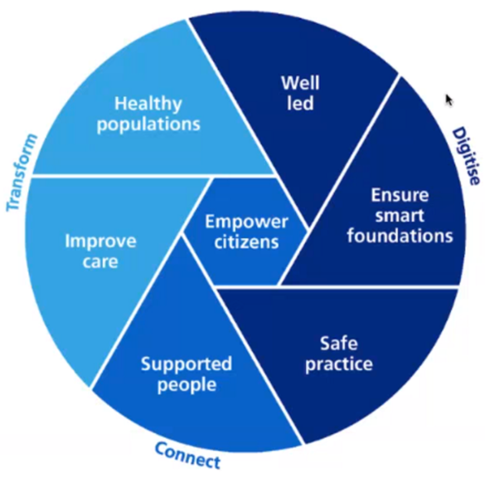
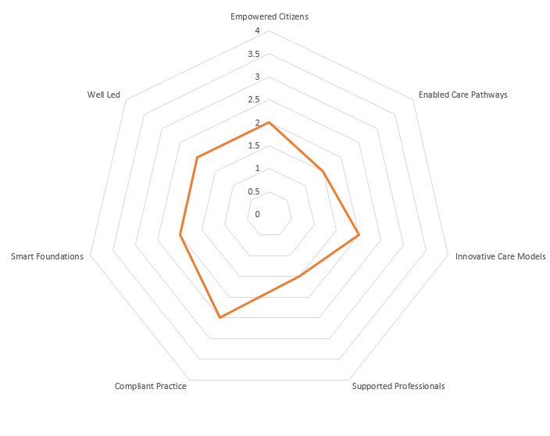
Where We Are Now
8
‘What Good Looks Like’ – 7 Domains of Digital Maturity*
Solent’s Self Assessed Digital Maturity – Summer 2021
Well led: Our leadership is confident and inspires a culture of digital transformation, data literacy, inclusion and collaboration.
Ensure smart foundations: we have reliable, modern, safe and resilient infrastructure and data capabilities. We review and continuously improve our core IT and digital services.
Safe practice: we ensure that our systems, and our use of technology meets and maintains high-quality safety and service standards.
Supported people: our workforce are digitally literate and empowered to work with data and technology systems – and we can work frictionlessly across our ICS.
Improve care: we make best use of technology and data to improve care pathways across our ICS.
Healthy populations: we have an effective strategy to encourage innovative thinking, developing new models of care informed by data insights and digital capabilities.
Empower citizens: citizens are at the centre of our service design. We ensure that our digital services suit all health literacy, inclusion and demographic needs.
4 = outstanding
3 = good
2 = ‘in progress’
1 = ‘requires attention’
* NHSX published ‘What Good Looks Like’ digital maturity framework (August 2021) for provider organisations and ICSs to evaluate against.

Slide 16
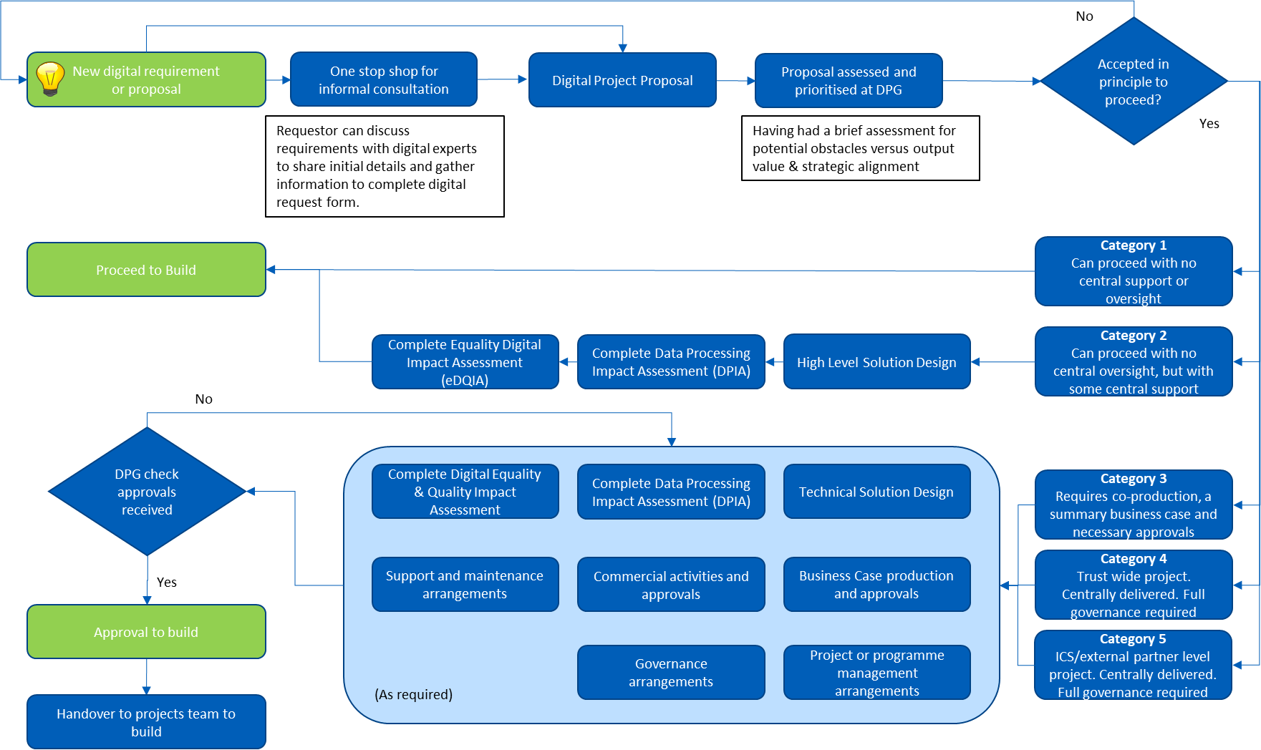
Harnessing Innovation – Digital Prioritisation Group
8
We recognise that those closest to our services and daily operations are the people who will have innovative ideas on how to improve on what we do.
We have a fledgling process in place that will enable staff to bring forth their ideas and we’ll seek to promote this, working across boundaries and encouraging collaboration across our teams.

Slide 17
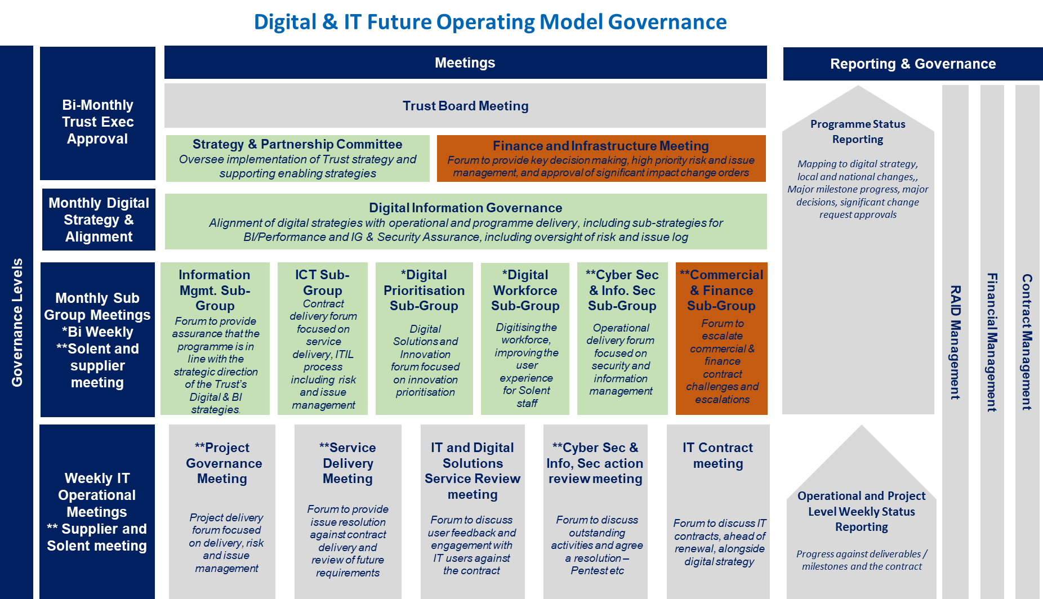
8
Governance
The Digital Information Group (DIG) will have oversight of the execution and delivery of the digital strategy, along with oversight and alignment of two sub-strategies for Business Intelligence & Performance and IG & Security Assurance.

Slide 18
Roadmap on a page
8
Timelines for delivering the capabilities identified within each of the 5 transformation journeys.
1 Year
3 Years
5 Years
Single source of truth and information assets managed
Actionable insights generated
Integrated data easily queried for insight
Unstructured data mapped & curated
Organisation, local & national data sets can be queried collectively to derive insight
System can prevent mismanagement of data, loss and corruption
Self-Service approach for BI
AI-enabled insights
Information Journey
Mechanism in place to prioritise & support improvements
Robotic process automation (RPA) introduced
Networks &Wi-Fi replaced, new devices for staff
Design Authority improves user experience of applications
Robotic process automation (RPA) strategy developed
Intuitive knowledge management system implemented
Efficiency Journey
Internet of Things (IoT) adopted
Service User Focus Journey
Cyber security programme developed and inflight
Smart Buildings are utilised across the estate
Applications & Services migrated to the cloud
Intelligent scheduling implemented into EPR
Digital experience enhanced and no. of applications rationalised
Clinical systems accessible on any device
Patients can access and interact with health records
Workforce Journey
Digital feedback loops used to monitor and inform continuous improvement
System Integration Journey
Patient-facing digital developments are tested for equality and quality
Community ‘digital panel’ engaged and contribute to digital developments
Electronic whiteboards in wards
Design & usability principles published to address digital exclusion
Digitised care pathways adhere to design principles
National, regional & local training resources utilised
Professional accreditation for healthcare informaticians and entry pathways
System usability issues identified and improved
Digital coaching & learning
Digital skills framework introduced to help people
Mechanism ensuring coordination between partners introduced
Digitally enabled improvements become BAU
Solent takes a leadership role in organisational
and ICS customs/practises alignment
Barriers for information flows in/out of Solent are diminished
Peer-to-peer relationships with ICS and partner orgs mapped
Solent customs and practises only differ from wider ICS by exception
Time

Slide 19
References
8
1. World Health Organisation Report
Global Strategy on Human Resources for health: Workforce 2030
Here: https://apps.who.int/iris/bitstream/handle/10665/250368/9789241511131-eng.pdf
2. Department of Health Statement to Parliament
Oral statement on the NHS Delivery Plan for tackling the COVID-19 backlog
Here: https://www.gov.uk/government/speeches/oral-statement-on-the-nhs-delivery-plan-for-tackling-the-covid-19-backlog
3. Topol Review
Preparing the healthcare workforce to deliver the future
Here: https://topol.hee.nhs.uk/
4. NHSX 5 Missions
Mission 1: Reduce the burden on the workforce
Here: https://nhsproviders.org/media/689235/nhsx-tech-vision-otdb.pdf
5. Delivering a Net Zero National Health Service
Here: https://www.england.nhs.uk/greenernhs/wp-content/uploads/sites/51/2020/10/delivering-a-net-zero-national-health-service.pdf

Slide 20
Questions

